Slide 1
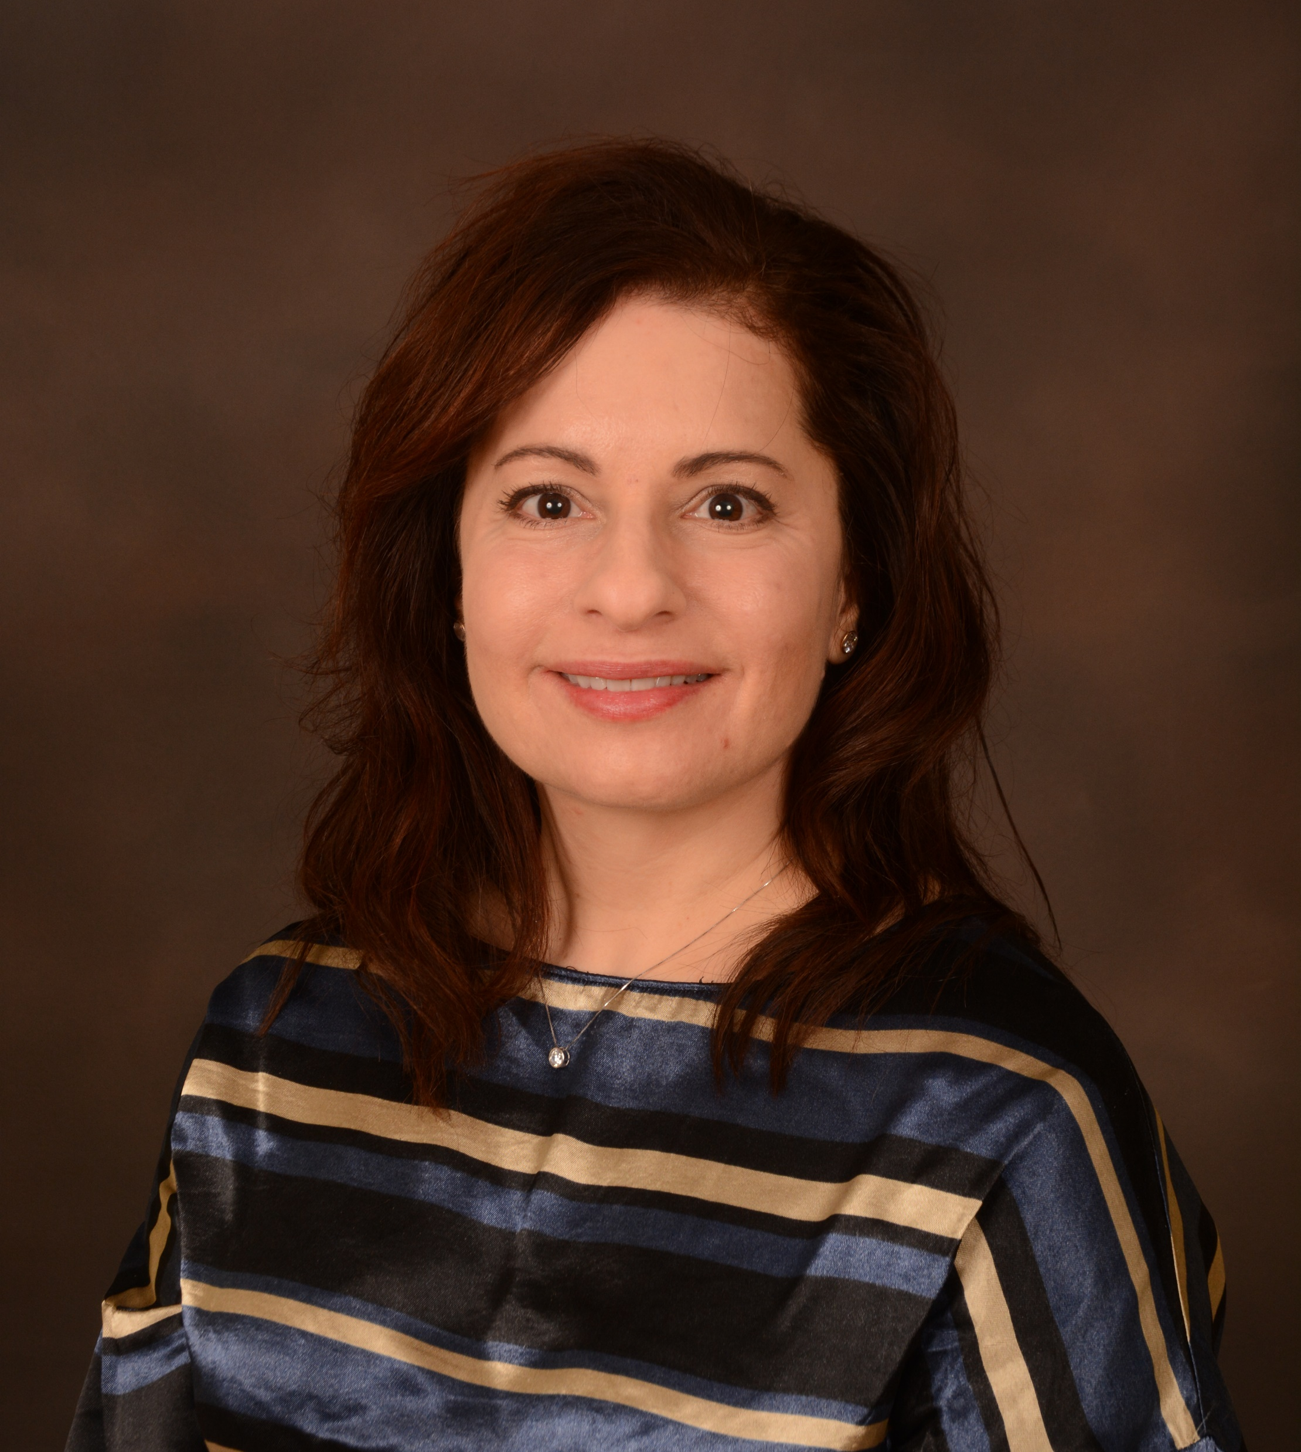
Innovate Share Impact
UM Pharmacy PRO Monthly Seminar (Open to the Public)
November 15, 2024, Friday, 3-4 PM (EST)
Zoom (open to the public): https://umich.zoom.us/j/958827
Scope of Diversity, Equity, and Inclusion Efforts at US Pharmacy Schools
Beatriz Manzor Mitrzyk, Pharm.D.
Assistant Professor
College of Pharmacy, University of Michigan, Ann Arbor, MI 48109
Pharmacy schools should strive to align education efforts with social accountability
DEI efforts can be a path to social accountability and improved health outcomes
In 2022, just over 10% of US PharmD programs were actively pursuing DEI efforts
Few programs aligned DEI efforts with social accountability metrics
Webpage: https://pharmacy.umich.edu/um-pharmacy-professor-research-outreach
LinkedIn Twitter YouTube

